Slide 1
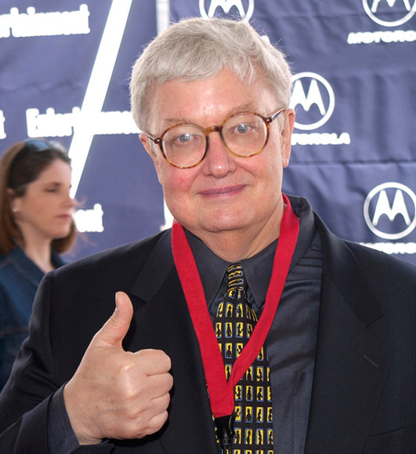

What do Facebook Users Know About Movies?
Do they know things??

Slide 2


Goal: predict critical reception using Facebook Likes
y = Metacritic score

Slide 3

Dataset
3200 movies titles from imdb.com
Metacritic score
Year of release
# of Facebook Likes of the top 3 billed actors
# of Facebook Likes of the director
# of Facebook Likes of the writer
# of Facebook Likes of the movie itself
Preprocessing: Log[features] (except release year)

Slide 4
Naïve Model
y = b₀+b_{a}X_{a_likes}+b_{w}X_{w_likes}+b_{d}X_{d_likes}+b_{m}X_{m_likes}+ε
Out-of-sample performance scored on 30% of the dataset set-aside initially
Ridge regression, cross-validated on the training set (10 splits)

Slide 5
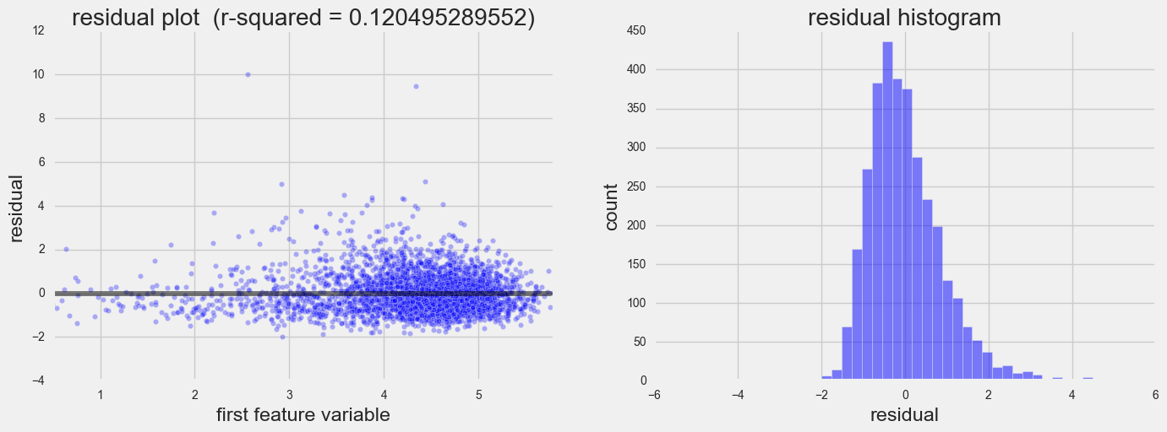
Naïve Model
R-squared: FB1 – 0.120

Slide 6
Group-Standardized Model
R-squared: FB1 – 0.120
Standardized data columns with movies released on the same year
y = b₀+b_{a}X_{a_likes}+b_{w}X_{w_likes}+b_{d}X_{d_likes}+b_{m}X_{m_likes}+ε
Out-of-sample performance scored on 30% of the dataset set-aside initially
Ridge regression, cross-validated on the training set (10 splits)

Slide 7
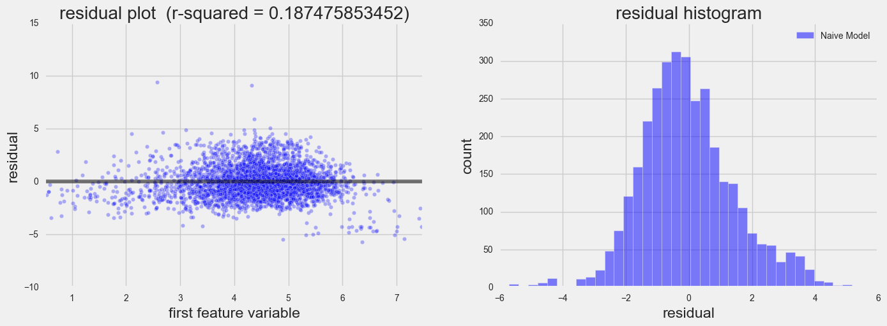
Group-Standardized Model
R-squared: FB1 – 0.120 | FB2 – 0.187

Slide 8
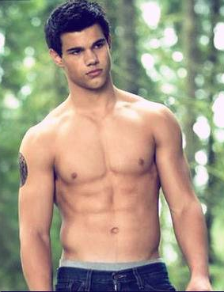
Conclusions so far…
R-squared: FB1 – 0.120 | FB2 – 0.187
Insignificant features:
Writers ‘Likes’
Nobody cares about the writers
Actors ‘Likes’
People might not be ing their acting abilities (e.g. they might be voting for abs)
So what do Facebook users know about the movies?? Do they know things?
Not a whole lot…

Slide 9

Back to Scraping…
R-squared: FB1 – 0.120 | FB2 – 0.187
Adjusted thesis:
How well can we actually predict the preference of movie critics?
Hypothesis:
Critically-acclaimed directors, actors, writers make critically-acclaimed movies
Additional features scraped:
Awards + Nominations of
Top 3 billed actors
Directors
Writers
Same processing as before:
Log[features]
Grouped by year and scaled

Slide 10
New Model (with awards)
R-squared: FB1 – 0.120 | FB2 – 0.187
y = b₀+b_{aL}X_{a_likes}+b_{wL}X_{w_likes}+b_{dL}X_{d_likes}+b_{mL}X_{m_likes} +b_{aA}X_{a_awards}+b_{wA}X_{w_awards}+b_{dA}X_{d_awards}+ε
Out-of-sample performance scored on 30% of the dataset set-aside initially
Ridge regression, cross-validated on the training set (10 splits)

Slide 11
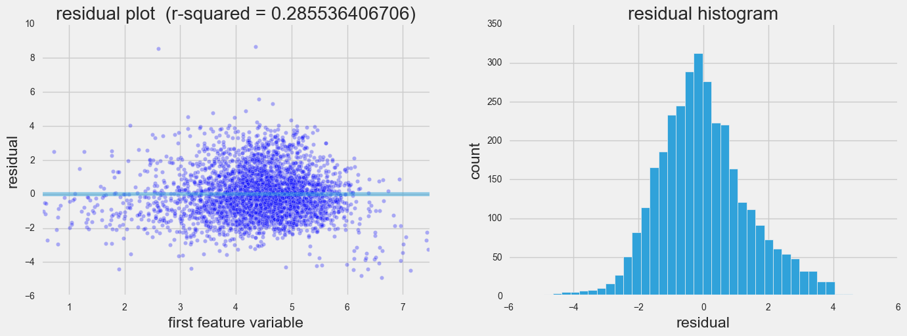
New Model (with awards)
R-squared: FB1 – 0.120 | FB2 – 0.187 | AW1 – 0.286

Slide 12
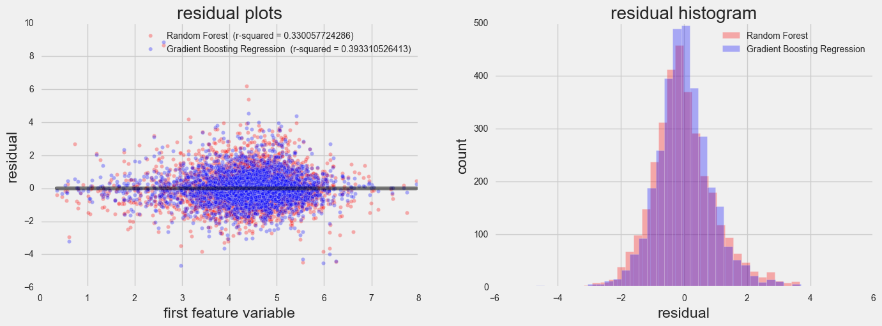
Ensemble Methods (with awards)
R-squared: FB1 – 0.120 | FB2 – 0.187 | AW1 – 0.286 | AW2,3 – 0.330, 0.393
Random Forest (r-squared ~ 0.330)
Gradient Boost (r-squared ~ 0.393)

Slide 13
Final Conclusions
Facebook knows nothing
Critically-acclaimed directors, actors, writers don’t always mean critically-acclaimed movies
See Ocean’s Twelve…
Critics might just be unpredictable rogues…
It would be nice if Metacritic published variance of the reviews for each movie too!
Ensemble methods = voodoo magic

